Slide 1
Ofsted Feedback Parent- 23/10/2023

Slide 2
Agenda
Ofsted Categories
Feedback
Next steps
What next

Slide 3
Ofsted and Categories
Ofsted team - Chris Davies (HMI), Katherine Chadbourne and Jennifer Lewis
What they do
Ofsted Grade 1: Outstanding
Ofsted Grade 2: Good
Ofsted Grade 3: Requires Improvement
Ofsted Grade 4: Inadequate

Slide 4
Graded Ofsted Categories
Quality of Education 2
Leadership and Management 2
Behaviour and Attitudes 2
Personal development 2
Early Years 2 (nearly 1)
Safeguarding Effective
Overall 2

Slide 5
Feedback Quality of Education
Phonics
School thoroughly researched phonics schemes.
Little Wandle is being used extremely effectively. 85% achieving national standard.
Focus on keep up – not catch up.
Pupils using strategies effectively

Slide 6
Reading (Deep dive)
Clear reading culture across school.
Parent phonics evening felt effective by parents.
Comprehensive and bespoke phonics training.
Positive pupils attitudes.
Very effective assessment and use of heat maps.

Slide 7
Maths (Deep dive)
Effectively sequenced curriculum.
Breadth and ambition for pupils with fluency and problem solving.
Links to curriculum throughout – every opportunity is taken to support maths in all areas.
Excellent independent use of resources, manipulatives and support. All with the same end point.
Revisiting prior learning through flashback 4.

Slide 8
Maths
Examples of excellent practice:
Revisiting learning.
Teacher and pupil modelling.
Live marking.
Well marked books and pupils responding and self correcting.
Maths Hub links.
Children clearly love maths.
Focussed intervention – pre teach identify gaps.

Slide 9
Science (Deep dive)
Knowledgeable and passionate subject leaders.
2 year curriculum effective for the school.
Clear progression and very clear progression maps.
Flashbacks a strength.
Pupils voice – helps us remember stuff
Clearly embedded.
Constantly assessing.

Slide 10
Science
Teachers actively pre-empt gaps
Teachers secure in knowledge.
Recalling prior learning.
Deliberate mistakes – really engaging discussion.
“I couldn’t get them to stop them telling me how much they love science”.

Slide 11
History (Deep dive)
Clear paths and intentions across the school.
Chronology threaded throughout the curriculum.
“Subject leader knows subject inside out, knows next steps and how it all breaks down”.
Victorians – learning to be historians. “It was really really nice”.
Excellent use of videos and pupil led discussion.

Slide 12
History
Used incredible language and the debates were rigorous and fierce.
Assessment tracks progress and attainment.
The teachers listen to what they children say and they listen to each other.
“The children wanted to tell us everything they have done, they clearly love history and learning and I was sad that I had to stop them”.

Slide 13
Art (Deep dive)
Clear intent across the curriculum.
Mapped out from EYFS to Y6.
Used to meet the children’s needs.
Great links to other subjects and joined up learning.

Slide 14
PE - (Shallow paddle)
Well managed and mapped out.
Knowledge built in.
Good teacher understanding.
Teachers modelled correct procedures.
Children knew what they were learning and what they had learnt.

Slide 15
Geography – (Shallow paddle)
Skills build progressively and are highlighted.
Good coverage of the curriculum in book and through discussion.
Fieldwork in clear and well planned.
Knowledge organisers show progression.

Slide 16
SEND
SEND fully incorporated into every class.
Curriculum intent the same and well differentiated.
Planning and targets carefully designed to supporting pupils with an EHCP achieving their outcomes.
“Parents couldn’t speak highly enough of the provision and care the pupils receive at your school”.

Slide 17
SEND
TAs are highly trained in phonics. “I could not see any difference in the quality of teaching between teachers and teaching assistants”.
Strong TA questioning and supporting learning.
Bespoke provision embedded across school, coloured paper, acetates, writing wedges, boxes for posture and ear defenders etc.
Effective links with all support services.
All children get what they need.

Slide 18
SEND
Loving and caring support.
Well staffed and everyone knew the children’s needs inside out.
Same message across the school.
Teachers breaking down learning and support.
Adult support very effective.

Slide 19
Leadership and Management
Clear vision and values for all leaders.
Values underpin school and strategic planning.
Leaders know where the school is.
Forward thinking.
Strong narrative against framework.
“Leaders are considerate and leadership has brought about positive change”.

Slide 20
Leadership and Management
Strong training and support.
Strong engagement with parents.
Parent comments are extremely positive and the parents feel they can approach school about anything.
Staff are incredibly proud of this school.
“Staff survey is exceptionally positive, which is unusual”.

Slide 21
Behaviour and Attitudes
Busy environments, pupils know expectations and routines in place.
Collective worship – really engaged children and linked to values. “Lovely to see”.
Pupils were very positive about behaviour and honest. “Sometimes people do bad stuff, we tell and it gets sorted”.
School parliament is fully inclusive, very confident and flourish with freedom given.

Slide 22
Behaviour and Attitudes
Attendance has improved in all areas and above national average.
100% attendance increased.
The number of children late to school is still an issue and positive action has been taken to address.
Behaviour policies followed consistently in all areas.
Systems are in place to identify, support and monitor any behavioural issues.

Slide 23
Behaviour and Attitudes
The vast majority of parents are very happy with the behaviour in school and how any issues are addressed.
Incidents and types of behaviours are tracked.
Lovely atmosphere in school.
Pupils are polite and courteous.
Staff spot issues and deal with them.

Slide 24
Governance
Governors are extremely passionate about the school, have a wealth of knowledge and diverse backgrounds.
They support leaders in the strategic leadership of the school.
Governance is effective.

Slide 25
Personal development
PSHE scheme is sequenced, development and age appropriate.
Builds over times and allows adaptation for the needs of the children.
Implementation – clear throughout school and especially in pupil discussions.
British Values are a strength.
Really positive emotional health, healthy living and expressing feelings.
Worry box is effective for pupils.

Slide 26
Parliament
All explained job roles.
Talked about road safety, meeting MP, recycling and clearly felt part of decisions.
They feedback to classes and the whole school.
Very confident young people, who are proud of their school.

Slide 27
Early Years
Passionate and actively seek to improve their offer.
Professional development is strong and actively sought out – Early Excellence.
Change curriculum to meet the needs of the pupils.
Lovely staff / pupils interaction, questioning and relationships.
A love of reading fostered.

Slide 28
Early Years
Encourage curiosity.
Role play – great use of real objects.
CPD – clear comprehensive and extremely effective.
Nurturing and positive relationships.
All learners active.
Children love learning.

Slide 29
Early Years
Transitions smooth.
Parent confident in provision and speak highly of staff. Staff very positive about the team ethos.
Children out in all weathers and clearly love it.
A remarkable outdoor space.

Slide 30
Safeguarding
Leaders and staff know families well and are proactive.
Procedures are in place – they are robust and tight.
The DSLs actively challenge outside agencies.
Records are detailed.
Leaders are knowledgeable and proactive.
Staff know procedures well and feel well supported by leaders.
Children feel safe.

Slide 31
Areas for development
Some foundation subjects are not as ambitious as they could be. Pupils are not consistently challenged in all aspects of these subjects. Leaders must ensure that all foundation subject curriculums are suitably ambitious and that they are implemented to meet high expectations, enabling pupils to know and remember more in all subjects.
MFL – In September 2024, we will only be learning French and using one scheme.
Computing – In September 2022, we started using a new scheme, which will address all the issues but not embedded yet.

Slide 32
Areas for development
Leaders have developed effective approaches to assessment in the core and some foundation subjects. However, they have not established secure approaches to assessment in all foundation subjects. In these subjects, teachers do not fully check pupils’ learning. Leaders should ensure that effective approaches to assessment are in place in all foundation subjects, enabling teachers to identify what pupils have learned and what they need to learn next.
Art – we identified that this was developing and we will be working with our school improvement advisor.

Slide 33
Next steps – School improvement Objectives
Curriculum – Developing and embedding assessment and coverage in foundations subjects to ensure consistency across the curriculum. Specific focus on Art, Computing and MFL.
ERS – Applying for ERS status as an autism specialist school. Ensuring smooth transition to becoming an ERS school and ensuring we have the right physical environment and teaching with the bespoke skills to meet the needs of the pupils.

Slide 34
Next steps – School improvement Objectives
Writing - Refine and embed approaches to securing basic skills, editing and improving and developing pupil vocabulary to meet or exceed national benchmarks.
Curriculum development – 1 - 2 year objective. Plan, deliver and evaluate a new bespoke curriculum to replace cornerstones for Geography, History and Science.

Slide 35
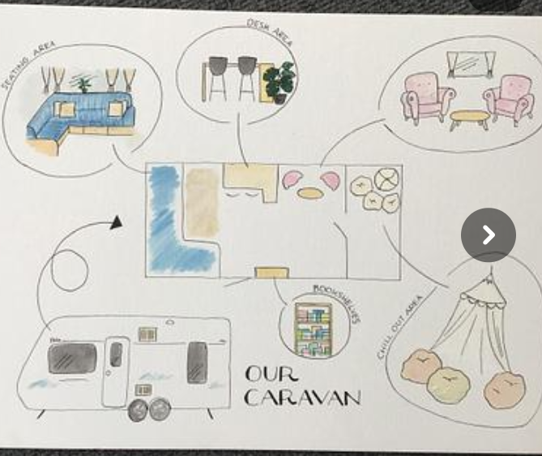
What next
Caravan – outdoor learning space

Slide 36
What next
ERS provision
Phonics champion school
OPAL outdoor learning
Literacy Tree
Reorganise the curriculum over the next 1- 2 years
Closer links with local schools

Slide 37
Gold system and badges
Gold system and badges
Bronze
Silver
Gold
Pupils who get the required number of gold awards will get to wear a bronze, silver or gold badge.

Slide 38
Attendance rewards
Good Attendance Award
Pupils achieving above 97% will get a good attendance badge.

