Slide 1
Pounds and pence

Slide 2
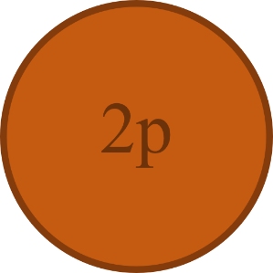
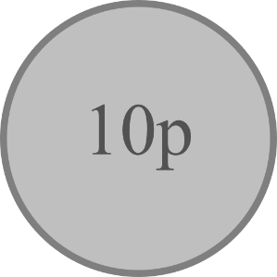
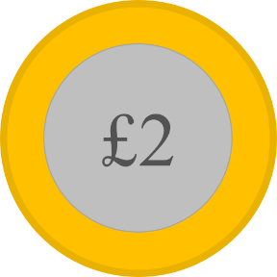
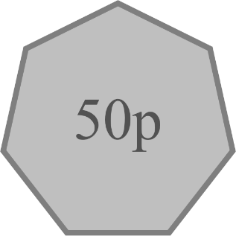
Learn it - Fluency
Robbie the Robber is a very bad man and stole some money from Mr Jones. How much money does he have in his swag bag?
There is pounds.
There is pence.
There is £ and p.
There is £ . .
22
62
22
62
22
62

Slide 3
Learn it - Fluency
The next day, he stole some money from Sarah before being caught by the police. How much money have the police find in his bag?
There is pounds.
There is pence.
There is £ and p.
There is £ . .
18
52
18
52
18
52

Slide 4
Learn it - Fluency
Complete the part-whole model to show the amount of pounds and pence.
£12
£12.83
83p

Slide 5
Learn it - Fluency
Complete the part-whole model to show the amount of pounds and pence.
£9
£9.47
47p

Slide 6
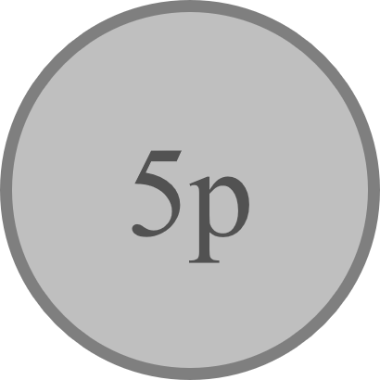
Learn it - Fluency
Complete the part-whole model to show the amount of pounds and pence.
£23
£24.03
103p

Slide 7
Learn it - Fluency
Complete the table.
643p | £ and p | £ . . | £5.31 | £ and p | p
837p | £ and p | £ . . | £7.04 | £ and p | p
404p | £ and p | £ . . | £6.87 | £ and p | p
6
43
6
43
5
31
531
8
37
8
37
7
4
704
4
4
4
04
6
87
687

Slide 8
Learn it - Fluency
Which of these correctly represent the amount of money shown?
£3 and 9p
£3.90
£390p
£3 and 90p
39p
£3.9
£3.90p
£3.09
309p
390p

Slide 9
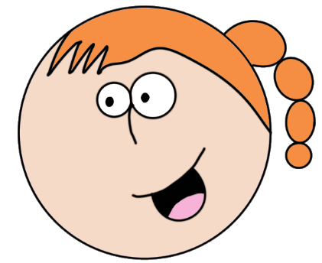
Learn it - Reasoning and problem solving
Three children are asked to convert pence into pounds.
Who do you agree with? What mistakes have been made?
Nobody. Alex = £13.90, she has ignored the 0 and not recognised it as 0p.
Danny = £5.09, he has not recognised the 0 as 0 ten pence.
Hatem = 630p, he has done the same as Alex.
1390p = £1.39
Alex
509p = £5.9
£6.30 = 63p
Danny
Hatem

Slide 10
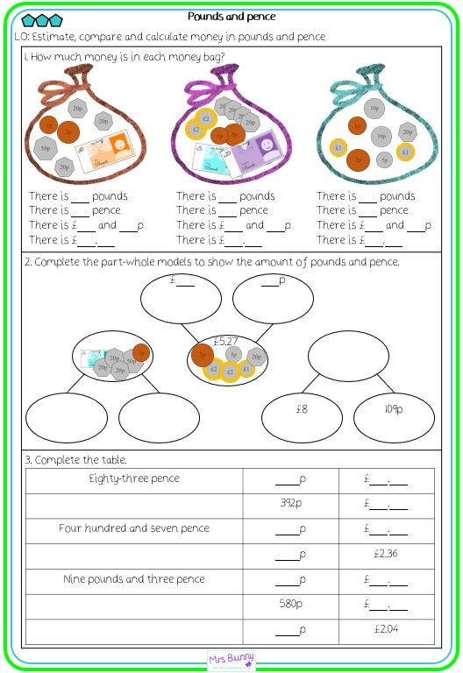
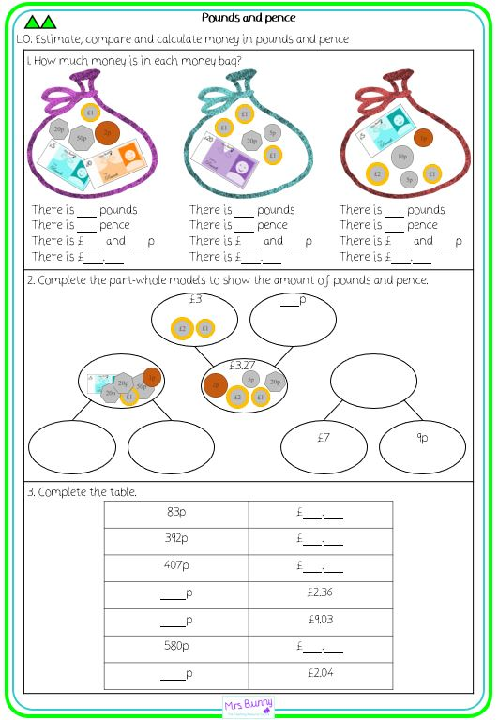
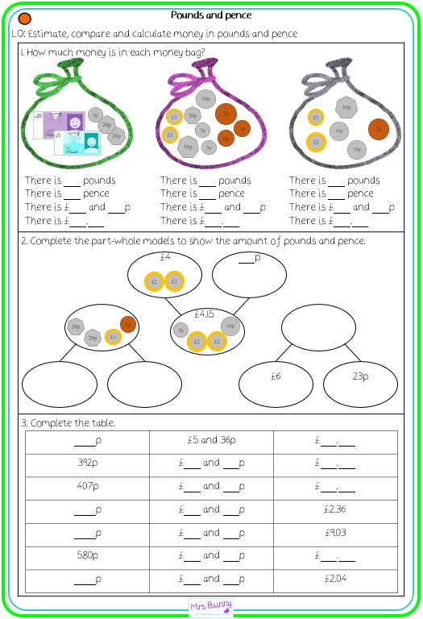
Practise it

